Slide 1
Chapter 1
Computer Abstractions
and Technology
只需要掌握8个伟大思想和CPU评价那些

Slide 2
1.1 Introduction

Slide 3
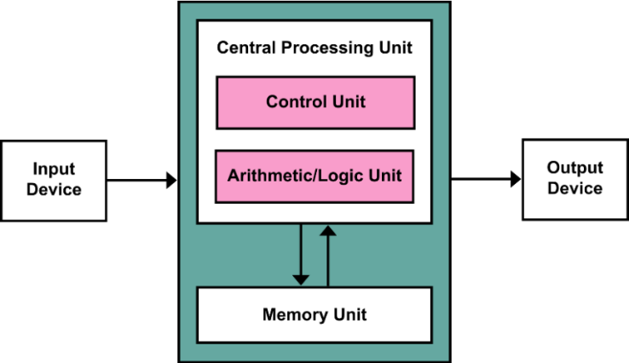
Von Neumann architecture (1945) 冯诺伊曼模型
“存储程序“的概念，采用控制流驱动， 计算与存储分离
按地址访问并且顺序执行行指令
数据与指令保存在同一个存储器，形式上没有区别。指令由操作码和地址码组成
输入设备I
输出设备O
运算器：核心是ALU
控制器：计数器PC（存放下一条指令的地址）,指令寄存器IR（存放当前指令），控制单元PU组成
运算器+控制器=CPU， CPU+主存储器=主机
存储器 存储字长是B（8bit）的整数倍
地址寄存器MAR：存放欲访问的存储单元地址
数据寄存器MDR：存放从存储单元取来的数据
5个部分

Slide 4
1.2 Eight Great Ideas in Computer Architecture

Slide 5
Design for Moore’s Law （设计紧跟摩尔定律）
Use Abstraction to Simplify Design (采用抽象分层简化设计)
Make the Common Case Fast (加速大概率事件) 优先优化常用功能
Performance via Parallelism (通过并行提高性能:多个流水线并行，行波加法器)
Performance via Pipelining (通过流水线提高性能)
Performance via Prediction (通过预测提高性能)
Hierarchy of Memories (存储器层次结构)
Dependability via Redundancy (通过冗余提高可靠性)
Express elevators in buildings
Increasing the gate area on a CMOS tran，sistor to decrease its switching time
类似福特的工业流水线
Library reserve desk

Slide 6
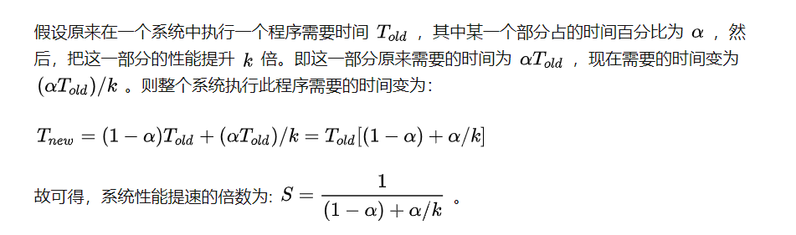
Idea3: Make the Common Case Fast
Amdahl's Law

Slide 7
1.6 Performance

Slide 8
Defining Performance
Response (Execution) time 执行时间
user perception
system performance
the only unimpeachable measure of performance 唯一无懈可击的业绩衡量标准
Mobile devices
CPU time
designer perception
CPU performance
Throughput
administrator perception
server
改进性能的方法 | Response time | Throughput
Replacing a faster processor | ↑ | ↑
Adding additional processors for a system use MP for independent task | - | ↑

Slide 9
Response (Execution) time
计算机完成一项任务所需的总时间，包括磁盘访问、内存访问、I/O活动、操作系统开销、CPU执行时间
CPU time
CPU用于特定任务的实际计算时间
Throughput(Bandwidth带宽)
在给定时间内所做的总功
单位时间内完成的任务数
CPU time is further divided into:
User time - time spent in user mode
System time - time spent in OS

Slide 10

Relative Performance
“Performance of P₁ is better than P₂ ” is, for a given work load L, P₁ takes less time to execute L than P₂ does
performance(P1) > Performance(P2)
⇒ Execution Time(P1, L) < Execution Time(P2, L)
“Processor X is n times fast than Y” is

Slide 11
CPU Clocking
时钟周期 Clock Circle Time
主频的倒数
主频（时钟频率）Clock Rate
主频越高完成一个指令所需要的时间越短
CPI cycle per instruction
执行一条指令所需的时钟周期数（时钟频率不影响CPI）
CPU执行时间
Instructions指令条数

Slide 12
CPI是执行所有指令的平均时间周期数

Slide 13
CPI Example
Alternative compiled code sequences using instructions in classes A, B, C
Class | A | B | C
CPI for class | 1 | 2 | 3
IC in sequence 1 | 2 | 1 | 2
IC in sequence 2 | 4 | 1 | 1
Sequence 1: IC = 5
Clock Cycles = 2×1 + 1×2 + 2×3 = 10
Avg. CPI = 10/5 = 2.0
Sequence 2: IC = 6
Clock Cycles = 4×1 + 1×2 + 1×3 = 9
Avg. CPI = 9/6 = 1.5

Slide 14
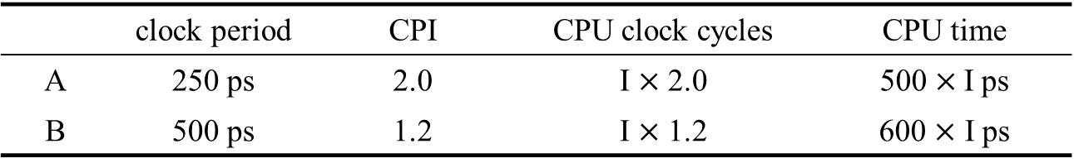
Example：Which is fast and by how much ?
 | clock period | CPI | CPU clock cycles | CPU time
A | 250 ps | 2.0 | I $×$ 2.0 | 500$×$ I ps
B | 500 ps | 1.2 | I $×$ 1.2 | 600 $×$ I ps
Answer: CPU PerformanceA Execution TimeB 600 * I ps
--------------------------- = -------------------------- = ------------------- = 1.2
CPU PerformanceB Execution TimeA 500 * I ps

